Slide 1
Basics Of XML
XML is a giant step in no direction at all.
-Erik Naggum

Slide 2
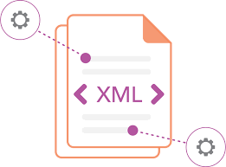
What is XML?
Store and transport data
eXtensible Markup Language
self-descriptive
W3C Recommendation
XML Does Not DO Anything

Slide 3
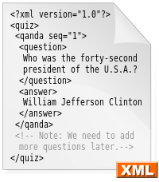

Why XML?

Slide 4
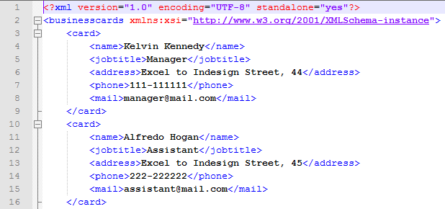
Structure

Slide 5

VIEW

Slide 6
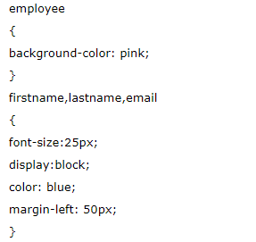
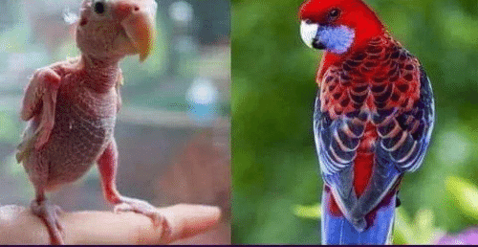
CSS
<?xml-stylesheet type="text/css" href="cssemployee.css"?>

Slide 7
DTD
<!ELEMENT employee (firstname,lastname,email)>
<!ELEMENT firstname (#PCDATA)>
<!ELEMENT lastname (#PCDATA)>
<!ELEMENT email (#PCDATA)>

Slide 8


